Slide 1


Prediction of Airbnb Prices
Presenters,
Madhulika Gadeveni
Rahul Yadav Nethula
Santhosh Reddy Pandiri
Murali

Slide 2
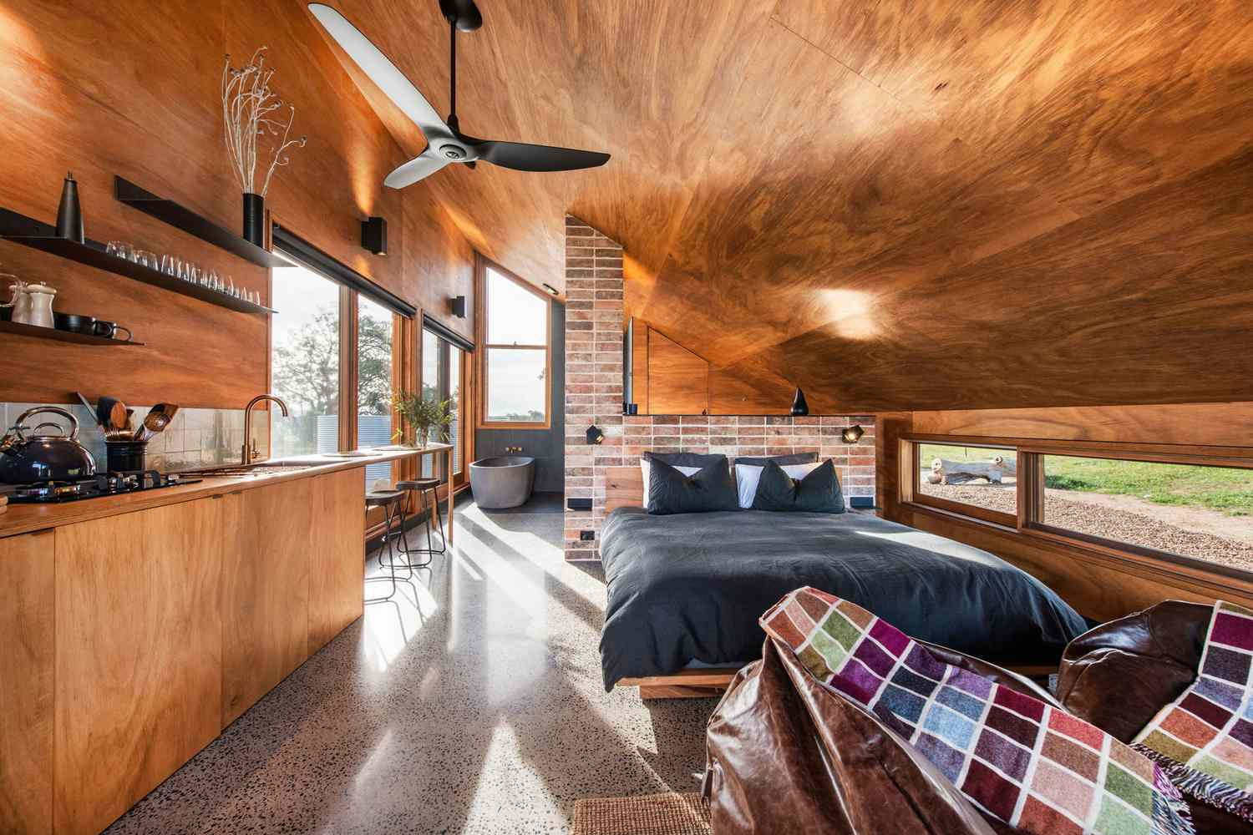
Introduction
Airbnb pricing is complex and influenced by a wide array of factors, including property location, amenities, time of year, and market demand. With thousands of listings in major cities, both hosts and guests are looking for fair pricing that reflects the value of the property while maximizing occupancy and profit potential for hosts. Using machine learning, we can analyze historical data to predict listing prices, helping hosts make informed pricing decisions and ensuring competitive rates that meet market demands.

Slide 3
Objective & Problem Statement
Objective: Predict Airbnb prices based on property characteristics, location, and other features.
Problem Statement: High variability in Airbnb prices makes it challenging for hosts to set optimal prices. This model aims to provide accurate predictions.

Slide 4
Data:
Dataset Source: Airbnb Open Data, including listings with features like location, property type, amenities, and previous pricing.
Purpose: Analyze Airbnb listings and predict prices based on property and host characteristics.
Key Features:
Host Info: Superhost status, identity verification.
Location: Neighborhood ("Roslindale"), latitude, longitude.
Property Details: Type, room type, accommodates, bathrooms, bedrooms, beds.
Amenities: Number of amenities included.
Pricing: Base price, additional guest charges, minimum nights.
Reviews: Number of reviews, average rating, review activity span.
Cancellation Policy: (e.g., moderate, flexible, strict).
Price Category: Price range labels (e.g., “lte_$75,” “gte_226”).
Objective: Use these features to create a predictive model for Airbnb listing prices.

Slide 5
Data Preprocessing
Handling Missing Values: Drop or Impute strategies applied.
Outlier Treatment: Describe any outlier analysis and removal.
Feature Scaling: Standardization or normalization of features.
Feature Engineering: New features created to capture additional variance (e.g., location-based indices or amenity scores).

Slide 6
Methodology
Data Collection and Cleaning and EDA
Gathered Airbnb listings data with attributes like location, property type, room type, number of bedrooms/bathrooms, amenities, and prices.
Cleaned the data by handling missing values, encoding categorical variables, and standardizing numerical features for model compatibility.
Model Selection
Started with a baseline Dummy Regressor to set a benchmark for model performance.
Tested multiple machine learning algorithms, including:
Linear Regression for simplicity and interpretability.
Support Vector Machine (SVM) for handling high-dimensional spaces.
Decision Trees to capture non-linear relationships in data.
Random Forests to improve performance with ensemble learning.

Slide 7
Methodology
Model Training and Evaluation
Split the dataset into training and testing sets to validate performance on unseen data.
Used Root Mean Square Error (RMSE) as the primary metric for comparing model accuracy.
Compared model results to identify the best-performing model for predicting Airbnb prices.
Hyperparameter Tuning
Performed grid search for hyperparameter tuning to optimize each model’s performance.
Focused on parameters like tree depth for Decision Trees and number of estimators for Random Forests.
Final Model Selection
Selected the Random Forest model as it achieved the lowest Test RMSE, indicating the best balance between bias and variance without overfitting.

Slide 8
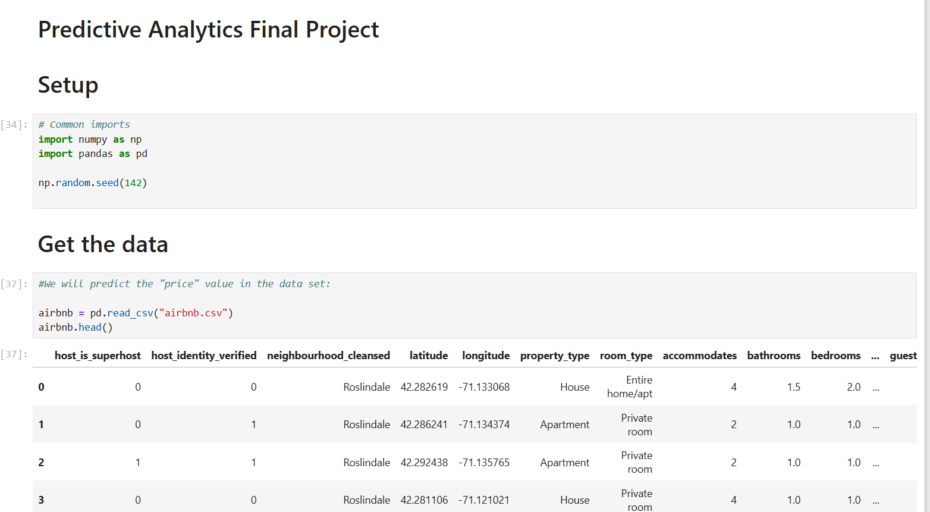

Slide 9
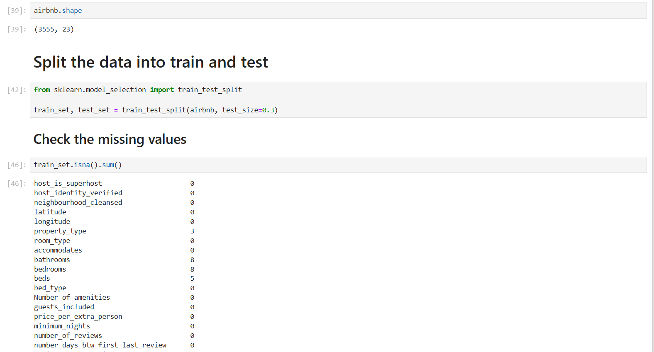

Slide 10
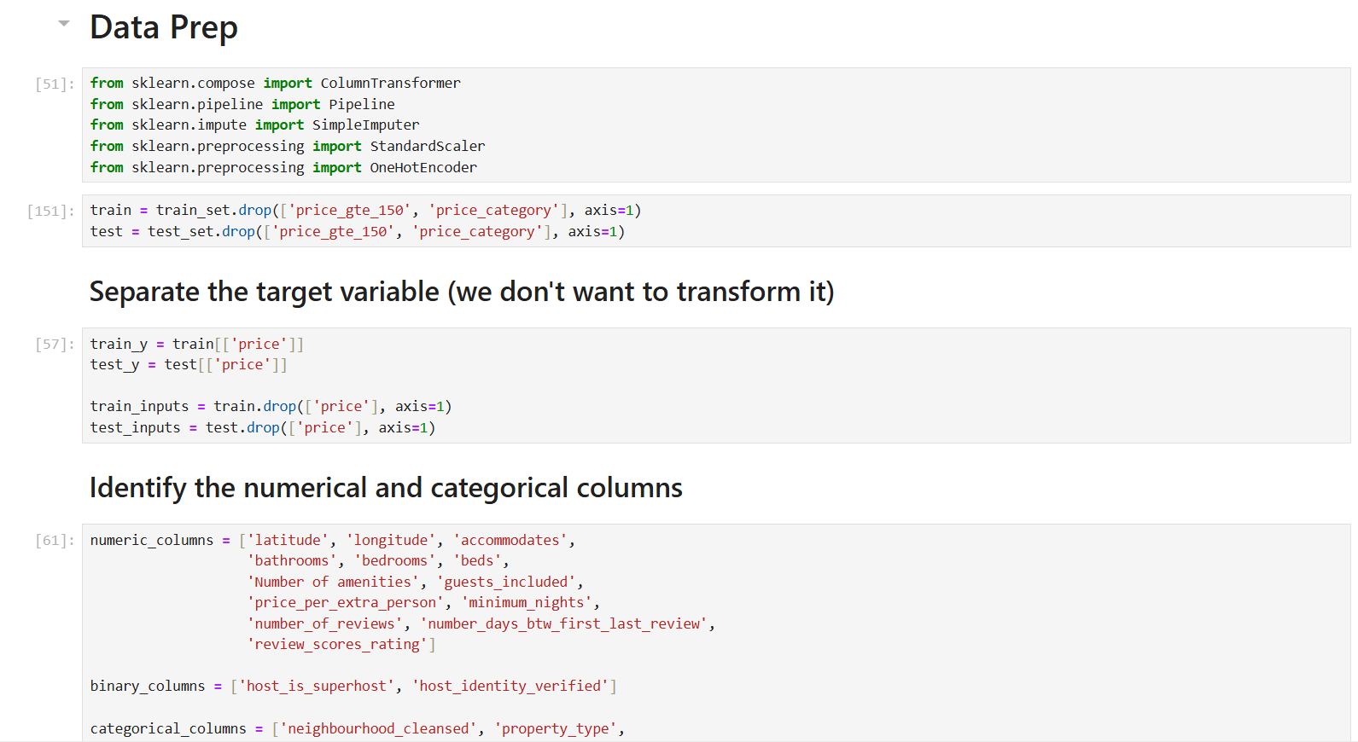

Slide 11
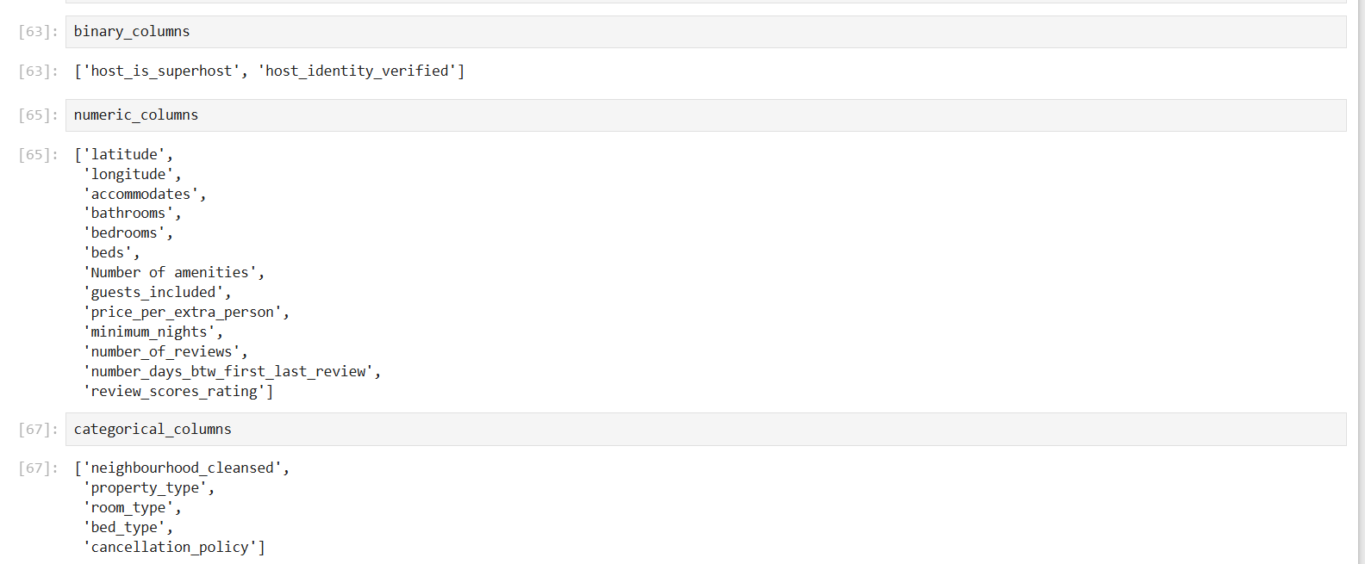

Slide 12
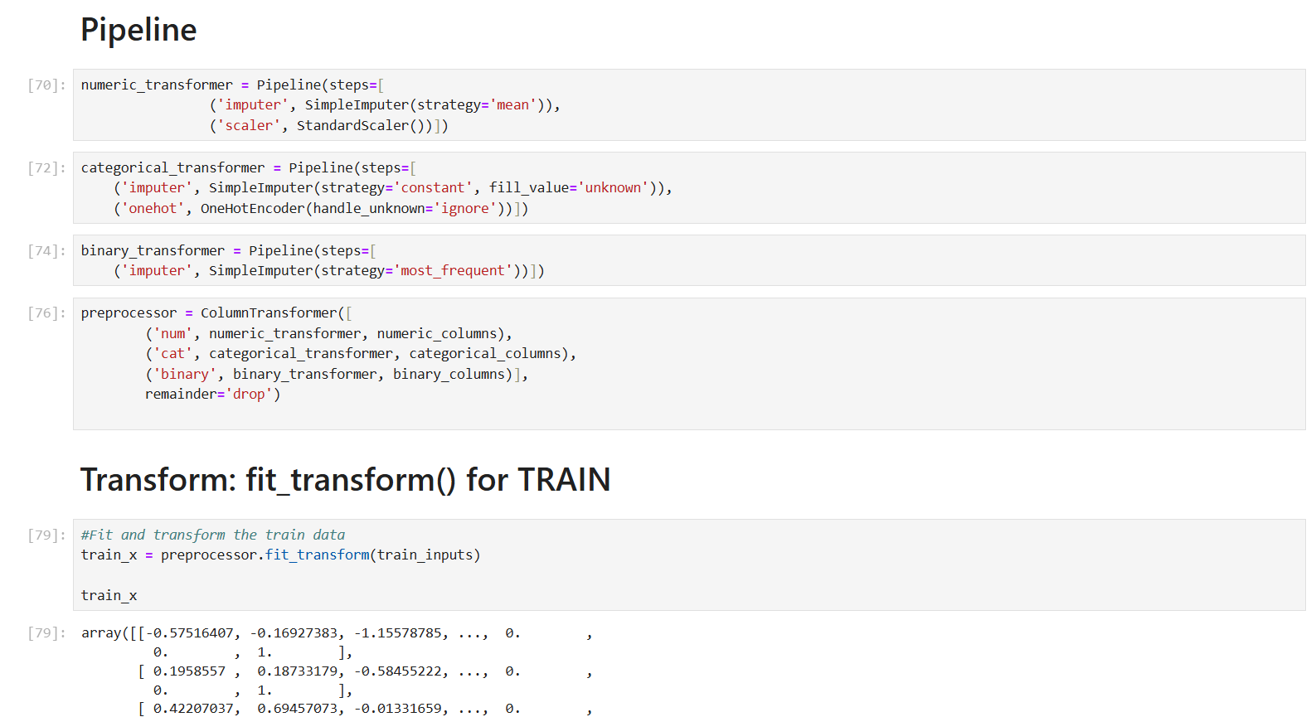

Slide 13
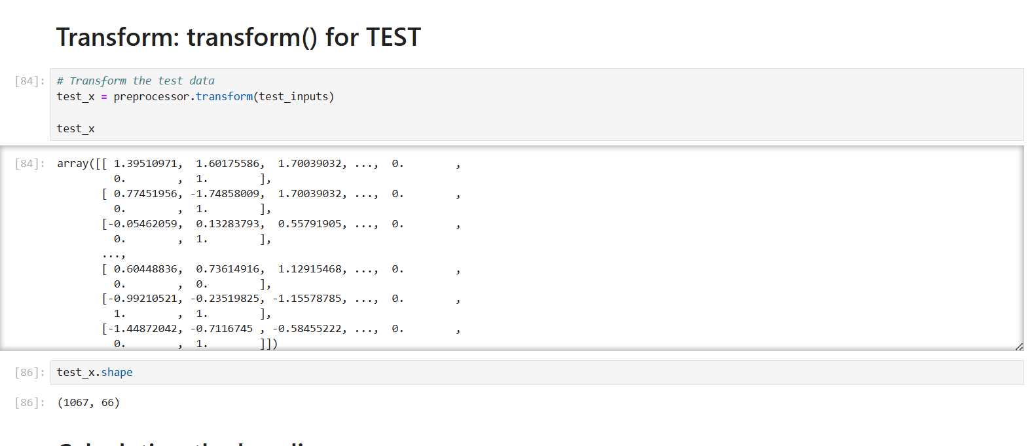

Slide 14
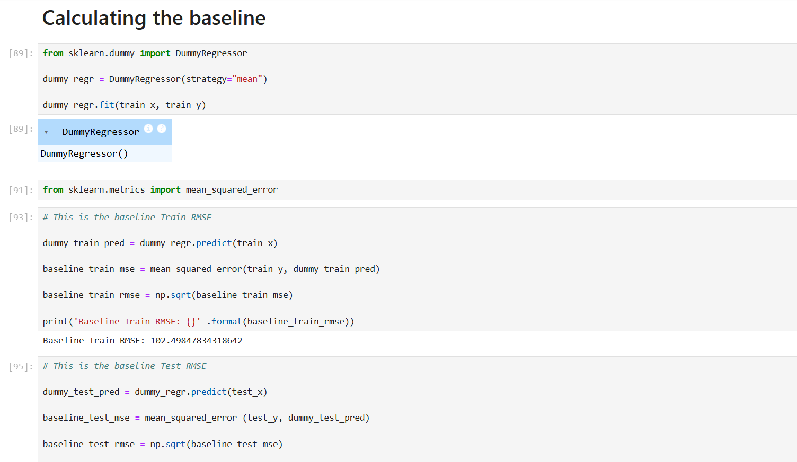

Slide 15
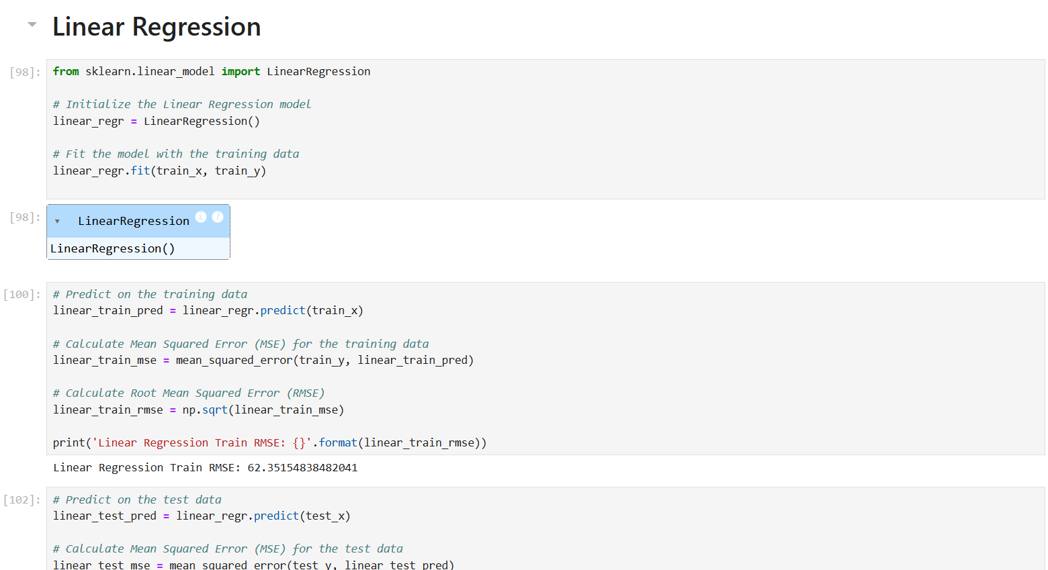

Slide 16
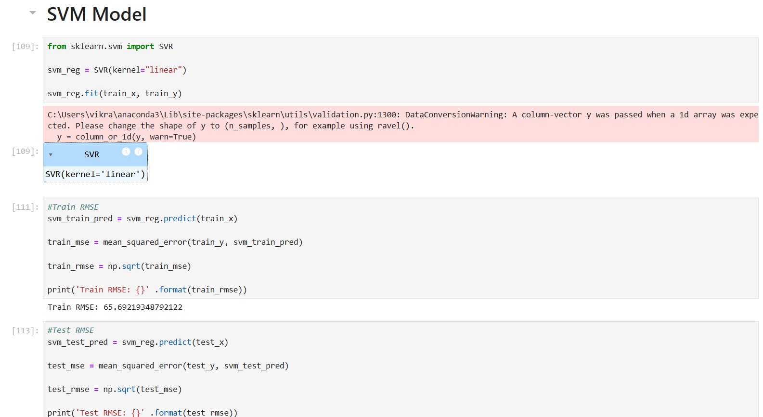

Slide 17
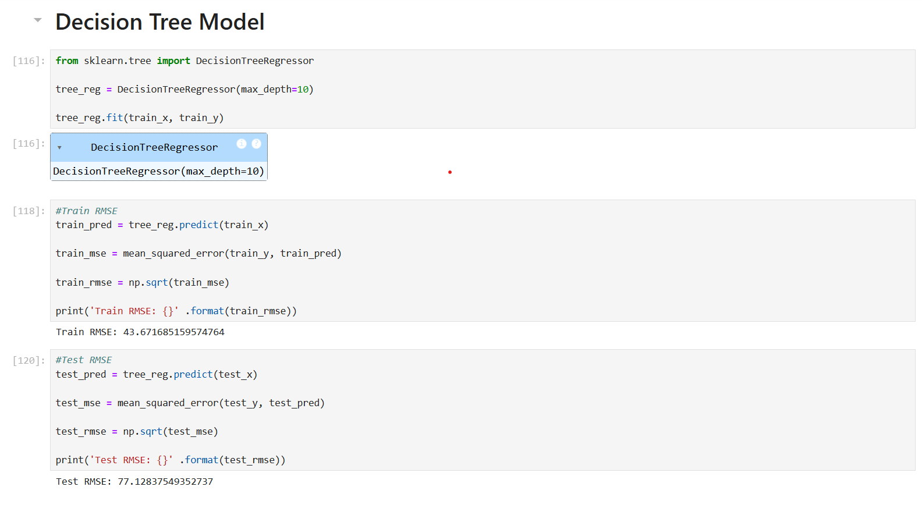

Slide 18
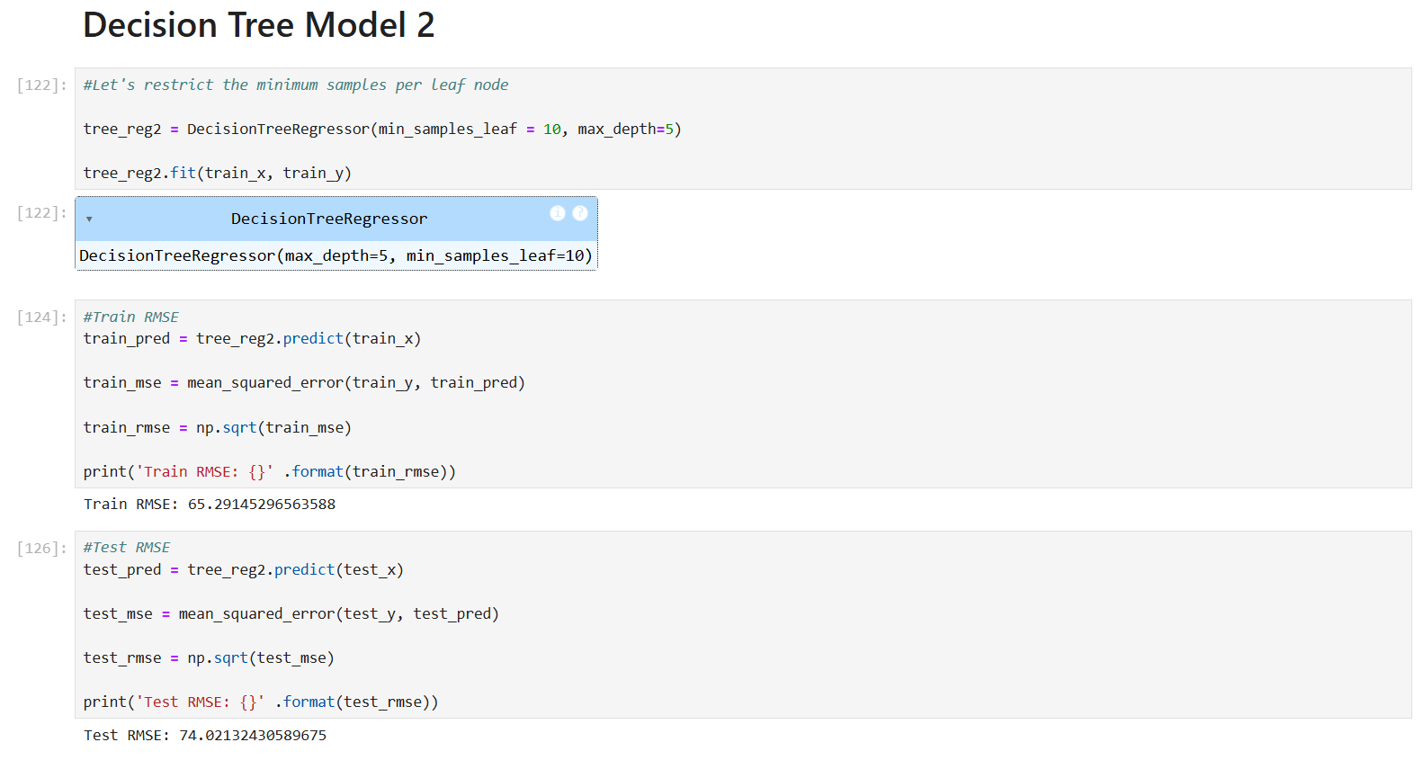

Slide 19
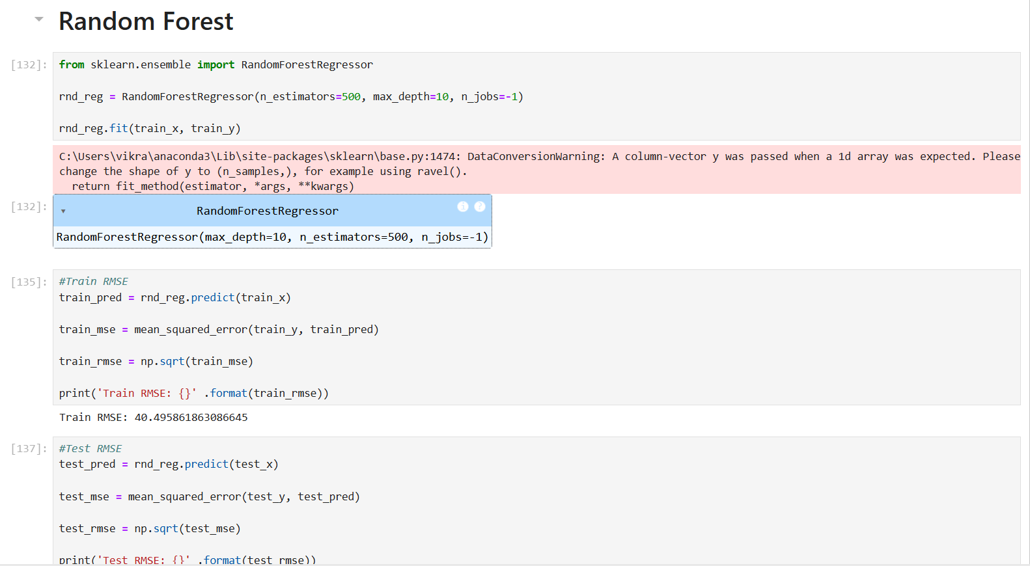

Slide 20
Results
Model | Train RMSE | Test RMSE
Dummy Regressor | 102.4985 | 105.36
Linear Regression | 62.35155 | 65.19963
SVM Regression | 65.69219 | 68.4896
Decision Tree | 43.67169 | 77.12838
Decision Tree 2 | 65.29145 | 74.02132
Random Forest | 40.49586 | 62.0575

Slide 21
Analysis:
Dummy Regressor: This model, which predicts the mean price for all instances, has the highest RMSE for both training (102.5) and test (105.4) data. It serves as a baseline, so all other models should ideally perform better than this.
Linear Regression: This model improves significantly over the Dummy Regressor with a Train RMSE of 62.4 and Test RMSE of 65.2. It indicates that Linear Regression is capturing patterns in the data fairly well.
SVM Regression: The SVM model has similar RMSE values to Linear Regression, with a slightly higher Test RMSE (68.5). This suggests it’s performing comparably but has a bit more error when predicting unseen data.
Decision Tree: This model achieves the lowest Train RMSE (43.7), meaning it fits the training data very closely. However, its Test RMSE is higher (77.1), indicating potential overfitting—it performs well on training data but not as well on new data.
Decision Tree 2: This version of the Decision Tree has a slightly better balance, with Train RMSE at 65.3 and Test RMSE at 74.0. It’s less overfitted than the first Decision Tree but still not ideal.
Random Forest: This model achieves the best results overall, with the lowest Test RMSE (62.1) and a low Train RMSE (40.5). This indicates that Random Forest generalizes well and captures complex patterns without overfitting.

Slide 22
Conclusion:
Among all models, Random Forest provides the best balance between training and test performance, making it the most effective model here for predicting prices accurately across both seen and unseen data. The other models either fit too closely to the training data or didn’t generalize as well on the test set.

